Slide 1
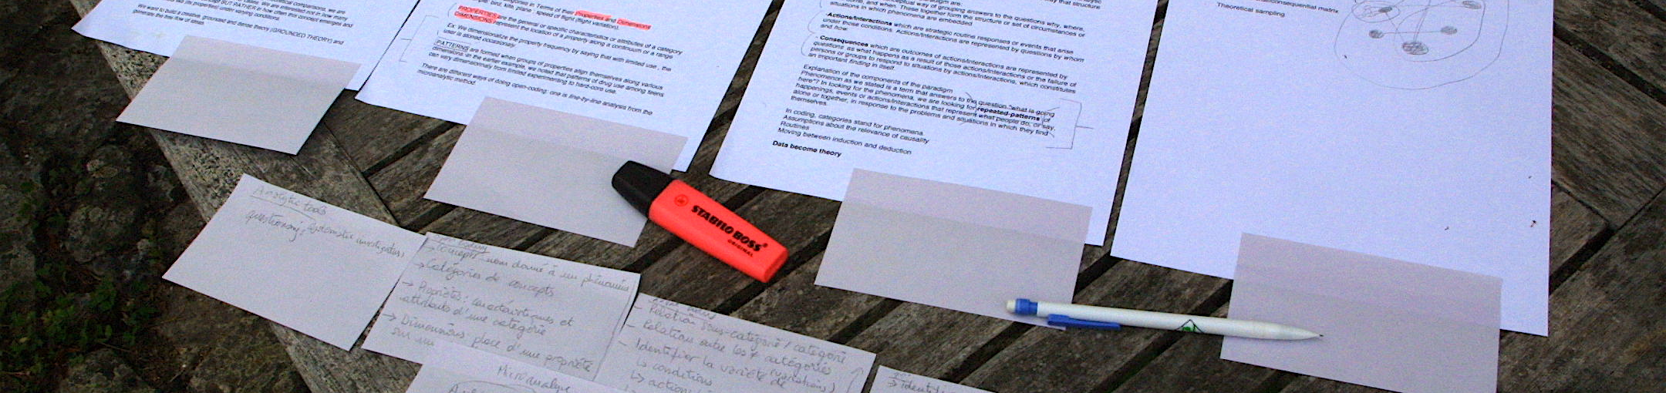

Writing a Scientific Report
The following content is licensed under a Creative Commons Attribution 4.0 International license (CC BY-SA 4.0)

Slide 2
Your Goal: A Scientific Report
You are doing an incredible job! Let‘s publish it!
But…
it is not your goal to publish a scientific report (would be great, but its really hard!!!)
it is your goal that your scientific report is in line with the standards of scientific pratices, scientific writing and open science
Good scientifc practice can only be showed in a scientific report → your marks depend on that
If your work lead to incredible results that can be published, we will contact you → your marks do not depend on that
Writing a Scientific Report

Slide 3
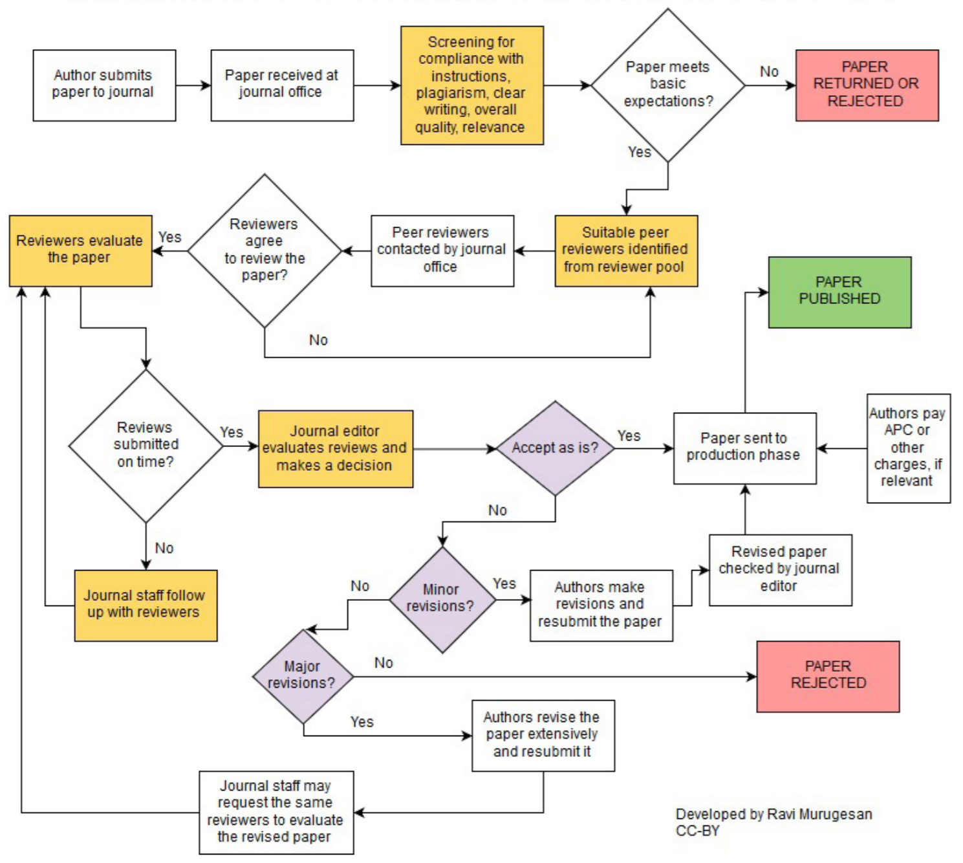
Scientific Reports: Living Documents
Writing a Scientific Report

Slide 4
Scientific Paper Types
Empirical Papers
describes the material and data used for the study, the methodologies applied to answer the research questions and the results obtained. It is very important that the study is described in a way that makes it possible for peers to repeat or to reproduce it (Day, 1983).
Case study papers
describe the application of existing methods, theory or tools. Crucial is the value of the reflections abstracted from the experience and their relevance to other designers or to researchers working on related methods, theories or tools.
Methodology papers
describe a novel method which may be intended for use in research or practical settings (or both), but the paper should be clear about the intended audience.
Theory/Position/White papers
describe principles, concepts or models on which work in the field (empirical, experience, methodology) is based; authors of theoretical papers are expected to position their ideas within a broad context of related frameworks and theories. Important criteria are the originality or soundness of the analysis provided as well as the relevance of the theoretical content to practice and/or research in the field
Writing a Scientific Report

Slide 5
Typical Structure
Abstract
Introduction
Motivation
Problem
Related work on the topic
Hypothesis
Related Work
Method
Design
Independent Variables
Dependent Variables
Measurement
Participants
Material
Procedure
Results
Descriptive statistics
Inferential statistics (No interpretation!)
Discussion
Brief summary of findings
Discussion/Interpretation of findings
Relation to previous/related work
Limitation of the study
Conclusion
Contribution
Acknowledgements
Writing a Scientific Report

Slide 6
Numbers
Use numbers if the number is huge:
„In our second study, 77 participants (38 female, 39 male) were recruited …”
Use textual numbers if they are small or at the beginning of a sentence
“Seventy-seven participants (38 female, 39 male) were recruited …”
Writing a Scientific Report

Slide 7
Tenses (1/3)
Abstract (composed as: see below)
Introduction
Typically Present Tense (now)
“Virtual reality (VR) is an experience taking place within simulated and immersive environments…”
Present perfect tense to report research
“A number of studies have been conducted to study presence…”
Related Work
Typically Present (now) if you write about Definitions, Statements, Constructs
“According to Slater et al. [1], presence is defined as…”, “Wong and Gutwin [53] propose …”
Past Tense if you describe things that happened
“Another approach to measuring presence was developed by Slater et al. [35,39]”
Writing a Scientific Report

Slide 8
Tenses (2/3)
Method (passive voice)
Typically Past Tense
“We conducted a study with the independent variables...”
Past Active
“We measured presence through three different Questionnaires…”
Past Passive
“Particularly the concepts of social or co-presence were investigated using…”
Present tense for diagrams and figures
“Means and standard deviations are shown in Table 2”
Writing a Scientific Report

Slide 9
Tenses (3/3)
Results
Past tense for results obtained
“We obtained the presence scores for each of the three questionnaires by averaging their 7-point scores.”
Discussion
Combination of tenses
“We found a systematic increase of the questionnaires’ variance”
“There are previous discussions about which questionnaire is the most appropriate measurement tool
Writing a Scientific Report

Slide 10
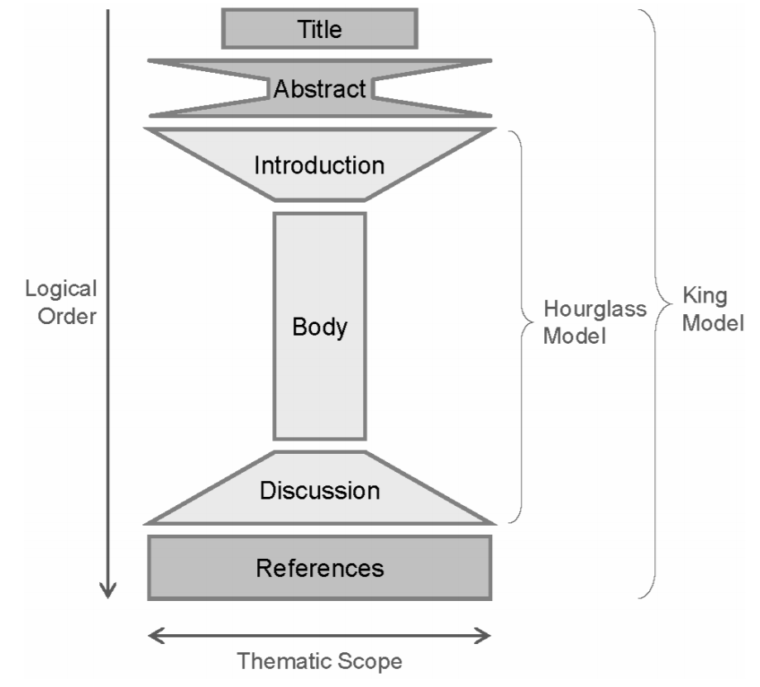
Your Paper as an Hourglass
Writing a Scientific Report

Slide 11
The Abstract
100-200 words
Briefly introduces the reader to
Relevance
Findings, suggestions, direction by previous work
The aims of the study
Method
Findings
Interpretation, Conclusion & Contribution
Ideally, each sentence deals about one section in your paper
The abstract answers these four questions:
Why did you do this?
What did you do?
What did you find?
What do your findings mean?
Writing a Scientific Report

Slide 12
The Abstract
Reflects the structure of the paper!
Bear in mind that there should be a match between abstract and paper, depending on the conference, journal, etc…
Mentions the contribution
How is the contribution articulated? (Which words are used, are there any ‘modulators’, e.g. ‘Perhaps … suggests … might … could …?)
Writing a Scientific Report

Slide 13
The Abstract
Who are intended readers?
What did you do?
Why did you do it?
What happened?
What do results mean in theory?
What do results mean in practice?
What is the key benefit for readers?
What remains unresolved?
Writing a Scientific Report

Slide 14
6 Sentences
Introduction. What’s the topic?
State the problem you tackle
Summarize why nobody else has adequately answered the research question yet
Explain how you tackled the research question
How did you go about doing the research that follows from your big idea
What’s the key impact of your research?
Look into: “How to write a scientific abstract” https://www.easterbrook.ca/steve/2010/01/how-to-write-a-scientific-abstract-in-six-easy-steps/
Writing a Scientific Report

Slide 15
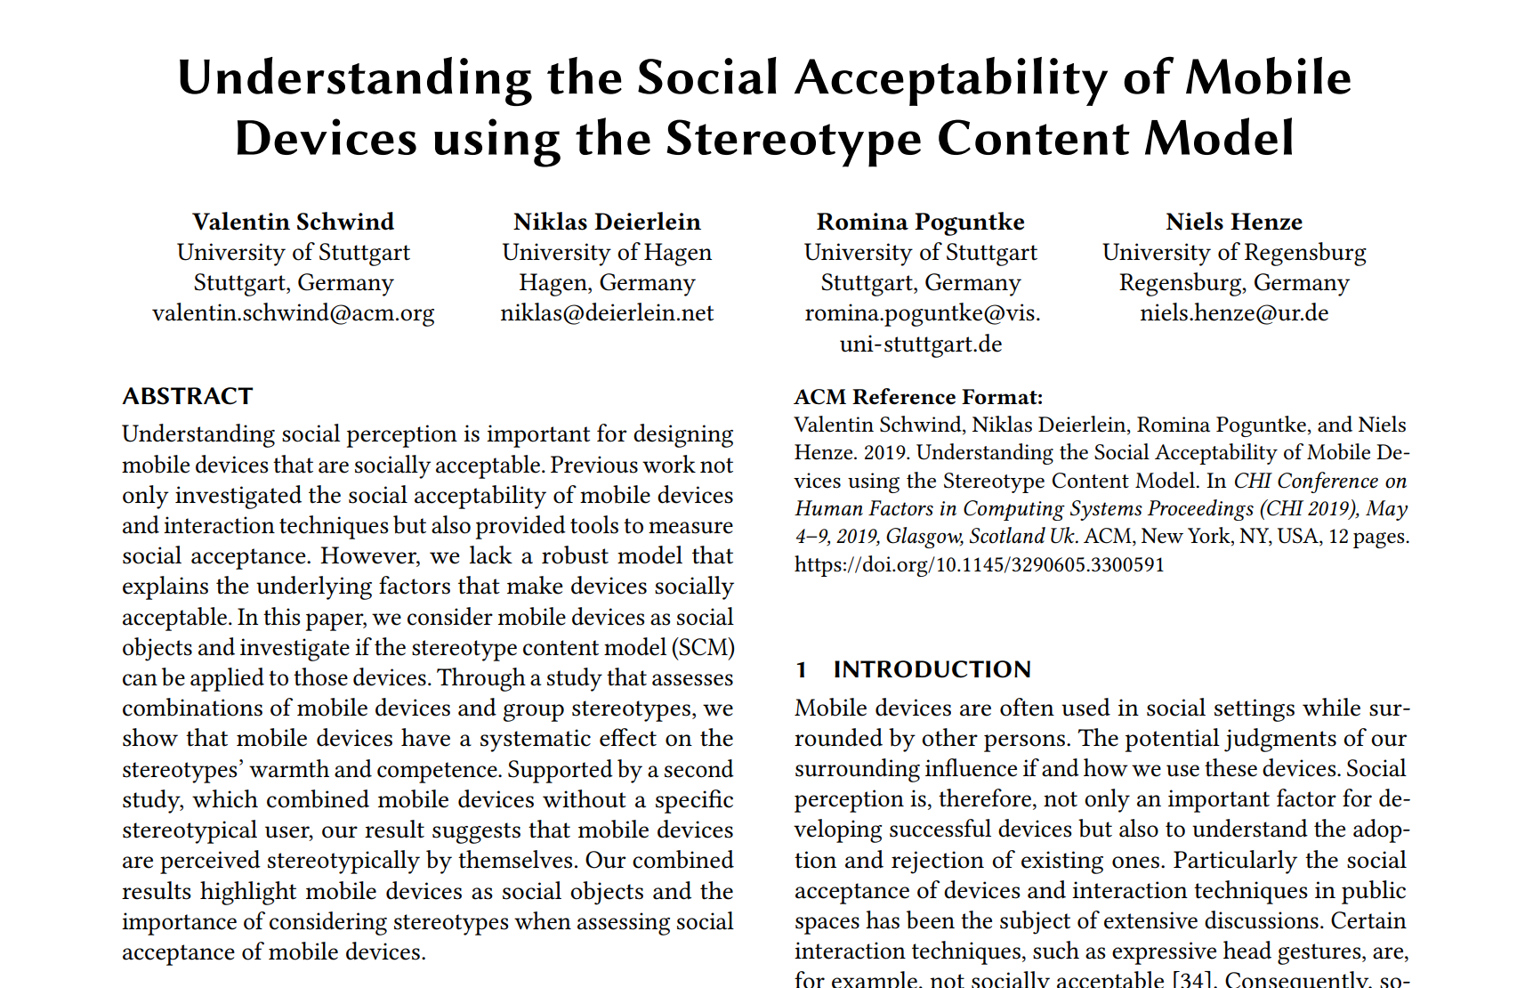
Example: Abstract
Writing a Scientific Report

Slide 16
Example: Abstract
“Understanding social perception is important for designing mobile devices that are socially acceptable.”
RELEVANCE
“Previous work not only investigated the social acceptability of mobile devices and interaction techniques but also provided tools to measure social acceptance.”
PREVIOUS WORK
“However, we lack a robust model that explains the underlying factors that make devices socially acceptable.”
THE PROBLEM
“In this paper, we consider mobile devices as social objects and investigate if the stereotype content model (SCM) can be applied to those devices.”
IDEA AND AIM OF THE STUDY
“Through a study that assesses combinations of mobile devices and group stereotypes, we show that mobile devices have a systematic effect on the stereotypes’ warmth and competence.”
METHOD + FINDINGS
“Supported by a second study, which combined mobile devices without a specific stereotypical user, our result suggests that mobile devices are perceived stereotypically by themselves.”
METHOD + FINDINGS
“Our combined results highlight mobile devices as social objects and the importance of considering stereotypes when assessing social acceptance of mobile devices.”
INTEPRETATION, CONCLUSION, CONTRIBUTION
Writing a Scientific Report

Slide 17
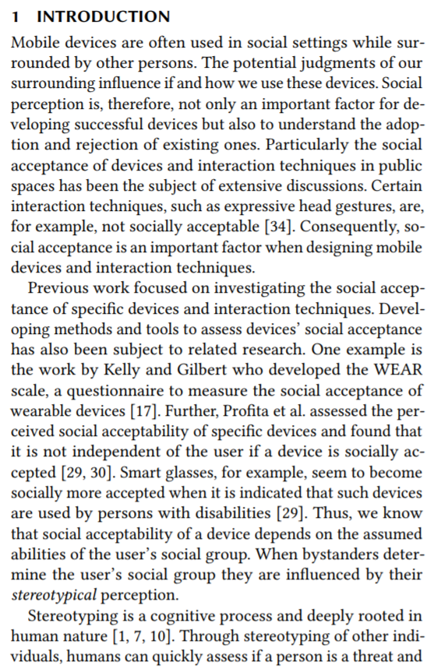
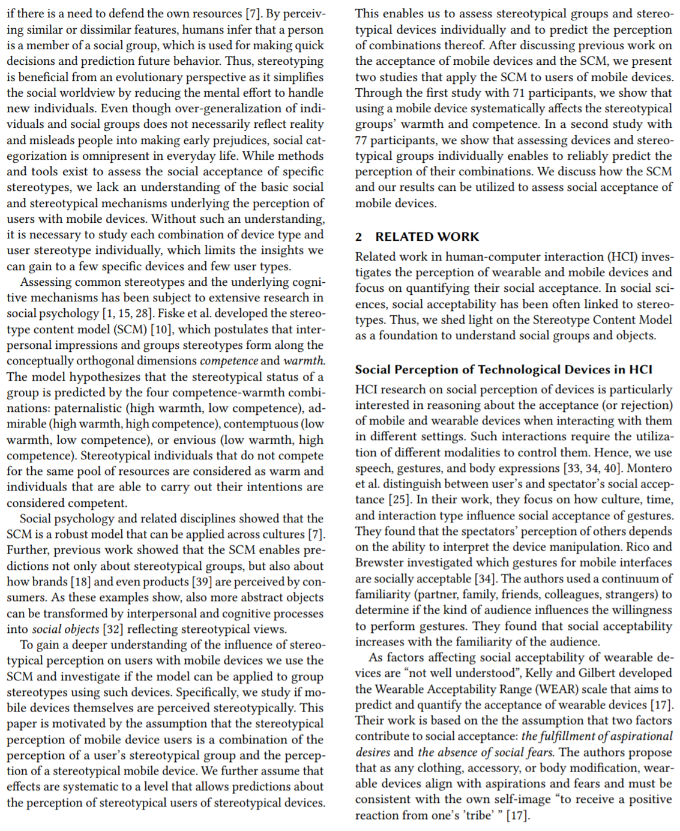
Example: Introduction
Why
What is the problem? Why is it important?
What could be a solution?
Paper Summary
What do we know from previous work?
Theory Background
Last paragraph of the introduction summarizes again the paper: intro, method, results, findings and contribution!
Why and how can we solve this problem?
Writing a Scientific Report

Slide 18
Introduction
The big picture
The statement problem
Brief background or relevant theory
Practices for your topic
Overall purpose, Motivation
The research question and hypotheses
Overview about the rest of the paper
Findings and contribution
Writing a Scientific Report

Slide 19
How to start a good Introduction
Establish a territory
bring out the importance of the subject and/or make general statements about the subject and/or present an overview on current research on the subject
Establish a niche
oppose an existing assumption or reveal a research gap or formulate a research question or problem or continue a tradition.
Occupy the niche
sketch the intent of the own work and/or outline important characteristics of the own work; outline important results; and give a brief outlook on the structure of the paper
Writing a Scientific Report

Slide 20
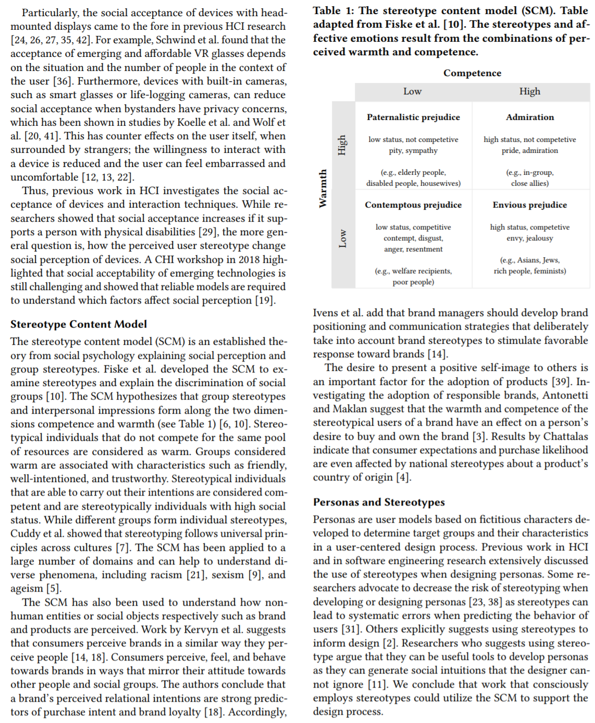
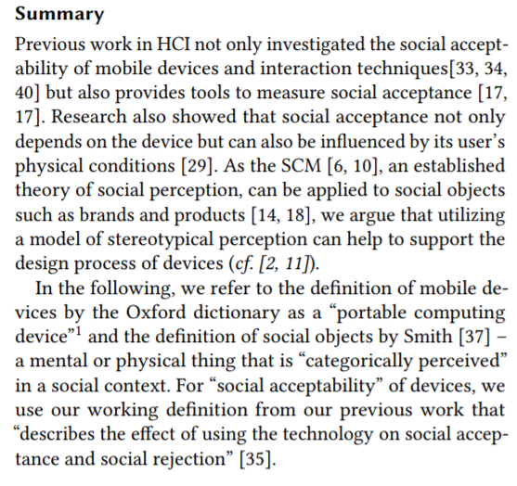
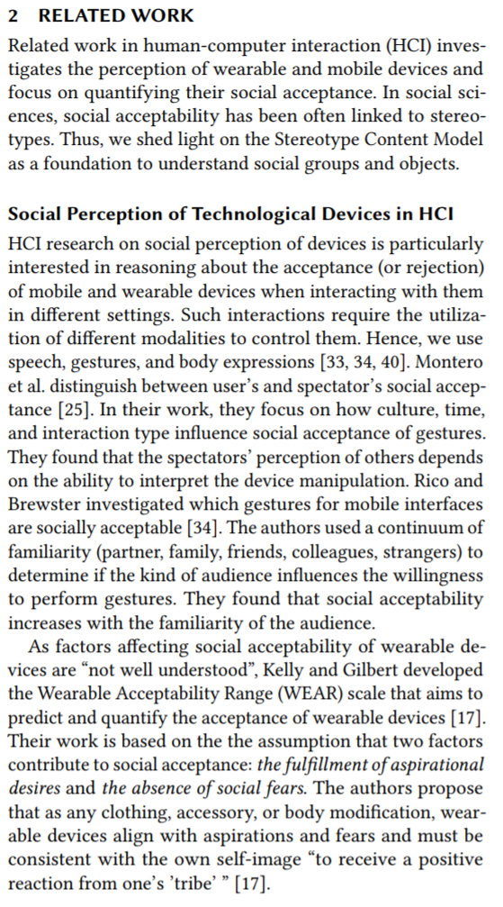
The Related Work
Topic Category #1
Topic Category #2
Related Work Summary
What do we read now?
Topic Category #1
Topic Category #2
Last paragraph summarizes the RW and definitions!
You can contrast your work: How is it related to the previous work?
Topic Category #3
Writing a Scientific Report

Slide 21
The Related Work
Summarize what is relevant (present state of knowledge)
Conclusions that have been reached until today
Do all writers agree with each other?
Are the experiments comparable?
What is the quality of the studies?
Main issue and controversies around the problem
Writing a Scientific Report

Slide 22
Literature Review
Name and year system
References are cited by their respective authors and the year of publication, e.g. ‘Chuck and Norris (2003) define …’. This system is very convenient for authors, as the citation does not have to be changed when adding or removing references from the list. The fact that sentences become hard to read when subsequently citing many references in one single parenthesis this way is one negative aspect for readers.
Alphabet-number system
This system lists the references in alphabetical order and cites them by their respective number in parentheses or (square) brackets, e.g. ‘As reported in [4], …’. This system is relatively convenient for readers, as it does not break the flow of words while reading a sentence with many citations. On the other hand, the author has to keep an eye on the references cited in the text as their numbers may change when the reference list is updated.
Citation order system
This system is similar to the alphabet-number system with one major difference: the reference list is not sorted alphabetically, but in the order of appearance (citation by number) in the text.
Writing a Scientific Report

Slide 23
How to cite
You can cite behind the name(s) or at the end of a sentence
Be consistent
One Author
“In 1980, Minsky [19] introduced the concept of telepresence …”
Two (or three) authors
“Wittmer and Singer [42] developed …”
Multiple Authors
“A study by Usoh et al. [39] revealed …”
Multiple References
“Previous research highlights the importance of presence as an outcome of immersive virtual environments [3, 31, 43] ...”
Direct Citations
He concluded that “presence researchers must move away from questionnaires in order to make any progress in this area” [34]
Refer using “cf.”, if you have something interesting #
“… is currently the most cited presence questionnaire on Google scholar (cf. Table 1).”
Writing a Scientific Report

Slide 24
Abbrevations
Use existing abbreviations
“They also developed the immersive tendency questionnaire (ITQ)…”
You can define your own
“Nevertheless, the presence questionnaire by Witmer and Singer (in the following referred to as WS)…”
Do not use if they only happen once
Use ACRONYM packages for consistency!
\usepackage{acro}
\DeclareAcronym{VR}{short = VR, long = virtual reality}
…
\ac{VR} enables to go beyond the physical constraints of the real world. In \ac{VR}, users can ...
Writing a Scientific Report

Slide 25
The Method
Again: What is the problem and how do you investigate it?
Study Design
Stimuli
Apparatus
Measures
Procedure
Tasks
Participants
Data Analysis
Writing a Scientific Report

Slide 26
Study Design
What is your hypothesis (repeat it if you already mentioned it) and how to you want to answer it
“The hypothesis of our first study is that the perceived warmth and competence of a member of a known stereotypical group changes when the hypothetical person uses different mobile devices. We used an online survey to investigate different mobile devices and known stereotypes from social sciences.”
What is within, what is between?
Use capital letters for independent variables
“A two-factorial within-subject design was carried out with the independent variables Stereotype and Device.”
Use italic font to highlight different levels
“The between-subject variable Environment has the two levels inside and outside the VR. The within-subject variabl Virtual Realism has the two levels abstract and realistic scene
Writing a Scientific Report

Slide 27
Stimuli/Conditions
Refer to individual levels in your study design
Typical Questions:
What did you use?
Why?
How did you create it?
Where did you obtain it?
How were they selected?
Where can I find it, if I want to repeat the study?
How many stimuli?
What did the participants see?
Writing a Scientific Report

Slide 28
Apparatus, Tasks, Procedure
Apparatus
ALWAYS show your apparatus in your paper!!!!!!!!!!!!
What did the experimenter see?
What did the participant see?
Describe in what you build (highlights your skills ;)
How did participants use it?
Condense information: „To prevent motion sickness, we used an HMD with 90 FPS“
Tasks
What did the participants do?
Why/How did you select the tasks?
Procedure
Always start with „After giving informed consent,…”
Describes what happened to every participant
E.g. How were stimuli ordered in your procedure („The order of the conditions was randomized for each participant.”)?
Writing a Scientific Report

Slide 29
Measures
Say what you measured and why and how
“To assess the perceived workload using VR and the real-world questionnaires, we used the NASA TLX with 6 items.”
“Presence scores of the three questionnaires were obtained using a total of 52 items (6 SUS, 14 IPQ, 32 WS) on 7-point scales. All items were presented as described in the original work.”
Ensure that you used the state-of-the-art approach, if not, justify why
“To measure HR, subjects held smartphones in their right hands, putting the tip of their right hand's index finger on the camera on the back side of the smartphone, and held it in place with limited movement for 1 minute.
Writing a Scientific Report

Slide 30
Participants
Describe the Demographics!
“We recruited 71 computer science students (15 female, 56 male) as participants for the study.”
“Participants’ age ranged from 19 to 36 years ( M = 23.81,SD = 5.16).”
How were they compensated?
“Participants were compensated with credit points for their study course.”
Where did you find them?
“In our second study, 77 participants (38 female, 39 male) were recruited through mailing lists and social media platforms.
Did you exclude anyone?
“Three students already participated in the first study and were not excluded from the analysis.“
Writing a Scientific Report

Slide 31
Participants
Any special about them?
„All of them had a technical background in computer science or engineering.”
“A number of 13 participants wore glasses, 20 had previous VR experience.”
The participants section is (in HCI) typically the section where you talk about ethics and data protection
“The study received ethics clearance according to the ethics and privacy regulations of our institution.”
Writing a Scientific Report

Slide 32
Data Analyzes
How did you analyze?
Did you filter?
Why?
Which data did you use?
Example: Qualitative Analyzes
“Oral feedback was analyzed using axial coding to find related concepts that provide further insights into the visuo-haptic integration of the avatar hands. Two researchers went through all transcribed notes to check each other’s coding and to establish consistency in the assignment of codes to the same phenomena. Discrepancies between the two sets of annotations were resolved through discussion. Data of participants who took part in the pilot studies was not considered in the final evaluation”
Writing a Scientific Report

Slide 33
Model Creation
How were training data collected?
→ Report the study
How did you construct input vector
Network architecture
Layers
Cost function
…
Model Validation
Leave-one-out cross valdiation!
Comparison
Writing a Scientific Report

Slide 34
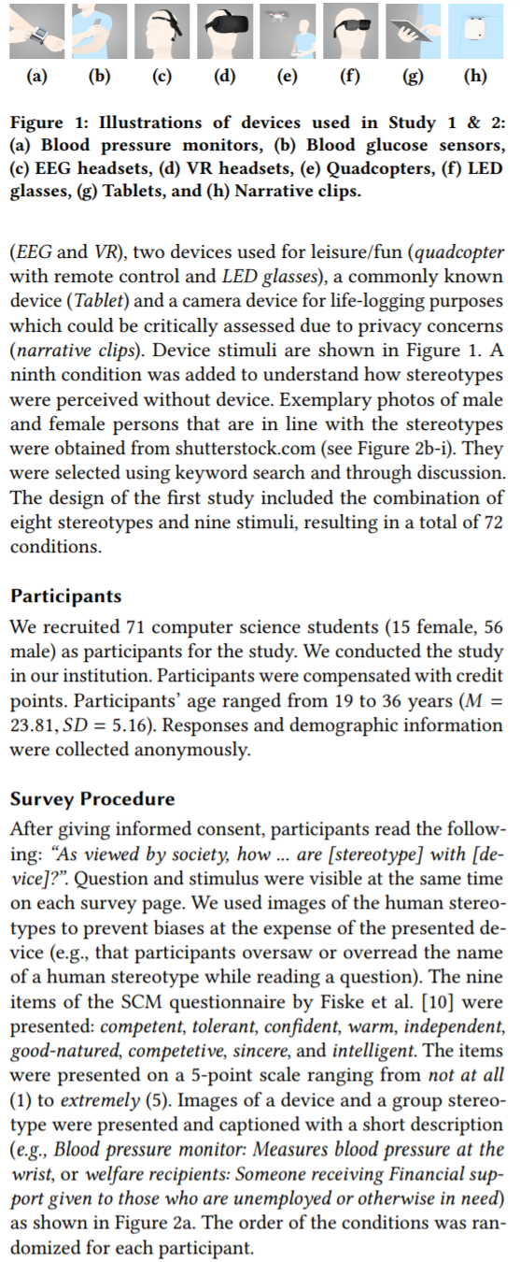
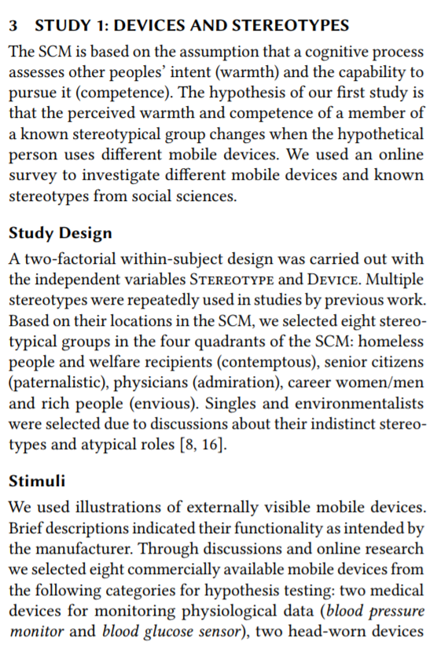
The Method
Stimuli/Conditions
What else can you report?
Measures
Scenarios
Figures of the Apparatus!
Data Analysis
Again: What is the problem and how can we solve it?
Procedure/Tasks
Study Design
Stimuli/Conditions
Participants
Writing a Scientific Report

Slide 35
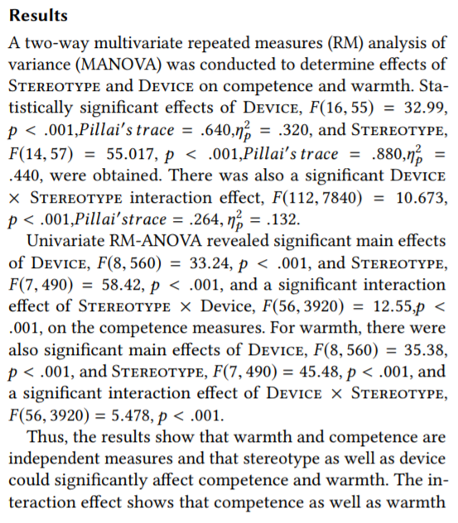
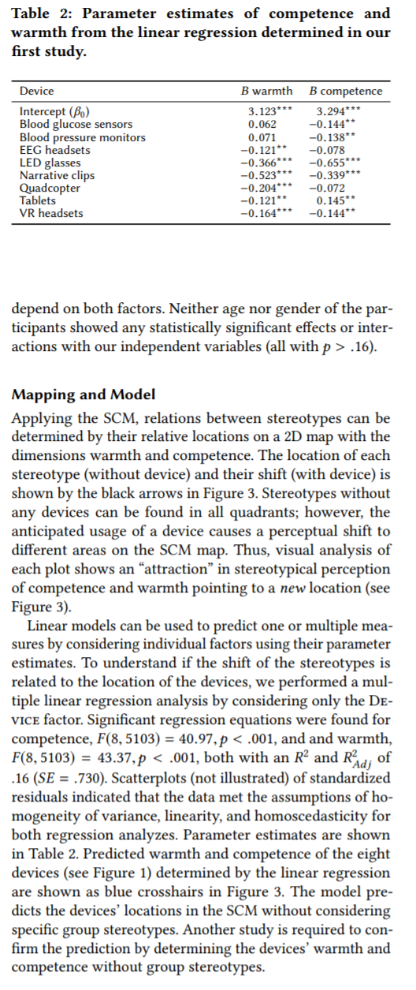
The Results
Inferential Statistics
Inferential Statistics
Results are often presented using tables!
A special view on the results
Statistics Help for Students!!!: http://statistics-help-for-students.com/
Writing a Scientific Report

Slide 36
The Results
Objective findings of your research (not the interpretation!)
Patterns from your Method (e.g. measures) must be found
Structured by
Quantitative and Qualitative Findings
Objective and Subjective Measures
Concepts
Research Questions, Hypotheses
Writing a Scientific Report

Slide 37
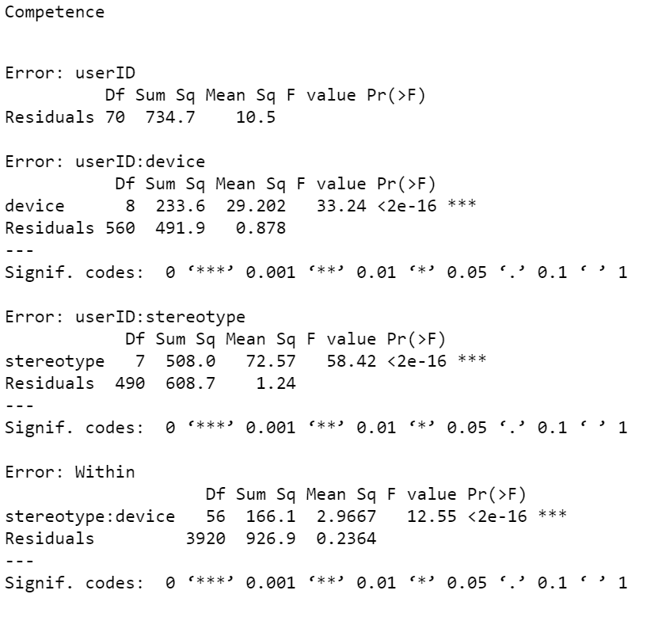
Reporting Quantitative Statistics
Quantitative Results are presented in APA-Style
Say your alpha level of p<0.05?
“There was a significant effect of ____________ on ______________ [F(___, ___) = ___, p = ____].”
F(df between, df within)= Test Statistic, p = p-value
Univariate RM-ANOVA revealed significant main effects of Device, F( 8 , 560 ) = 33.24, p < . 001, and Stereotype, F( 7 , 490 ) = 58.42, p < . 001, and a significant interaction
effect of Stereotype × Device, F( 56 , 3920 ) = 12.55, p < . 001, on the competence measures.
Writing a Scientific Report

Slide 38
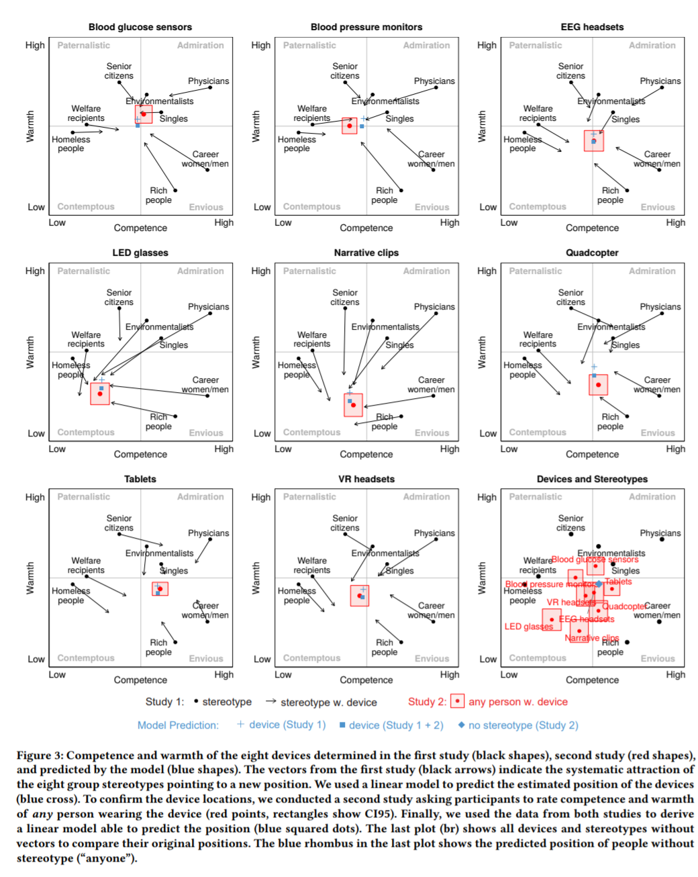
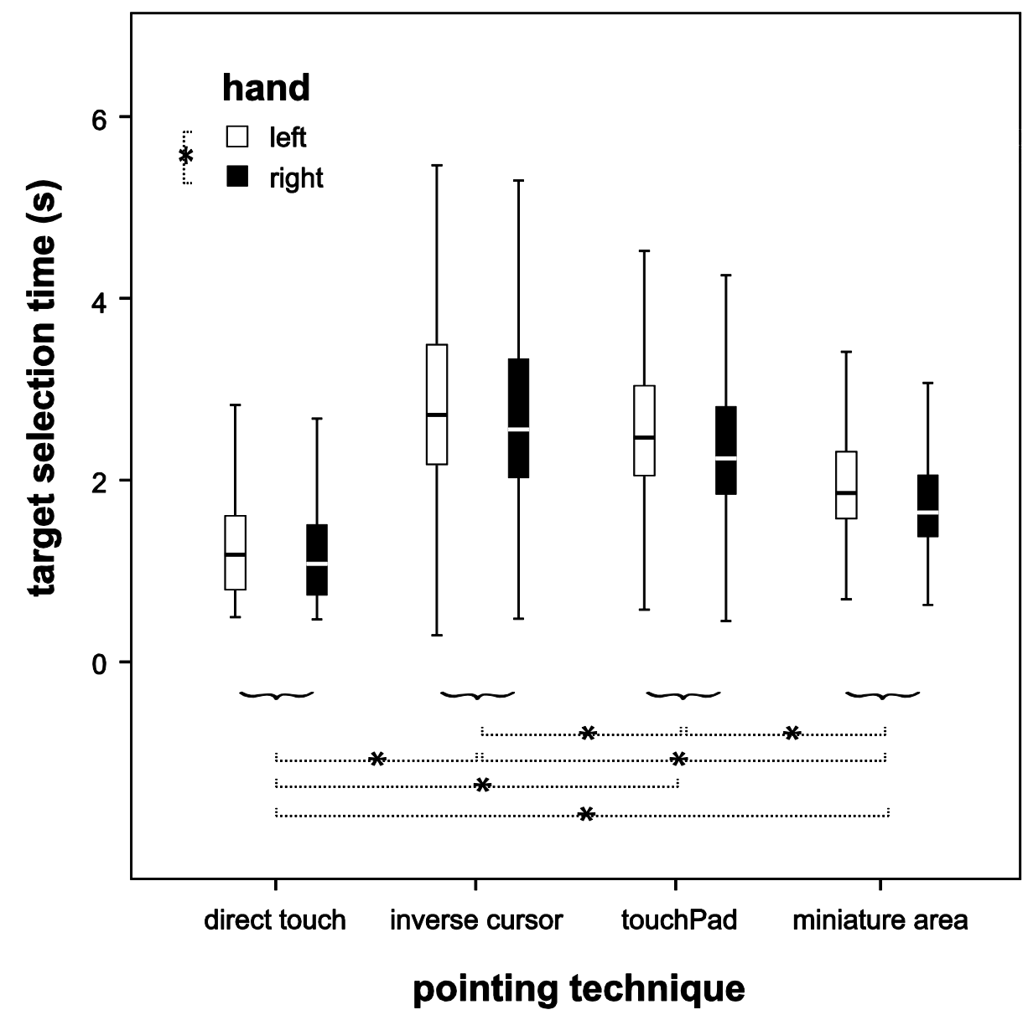
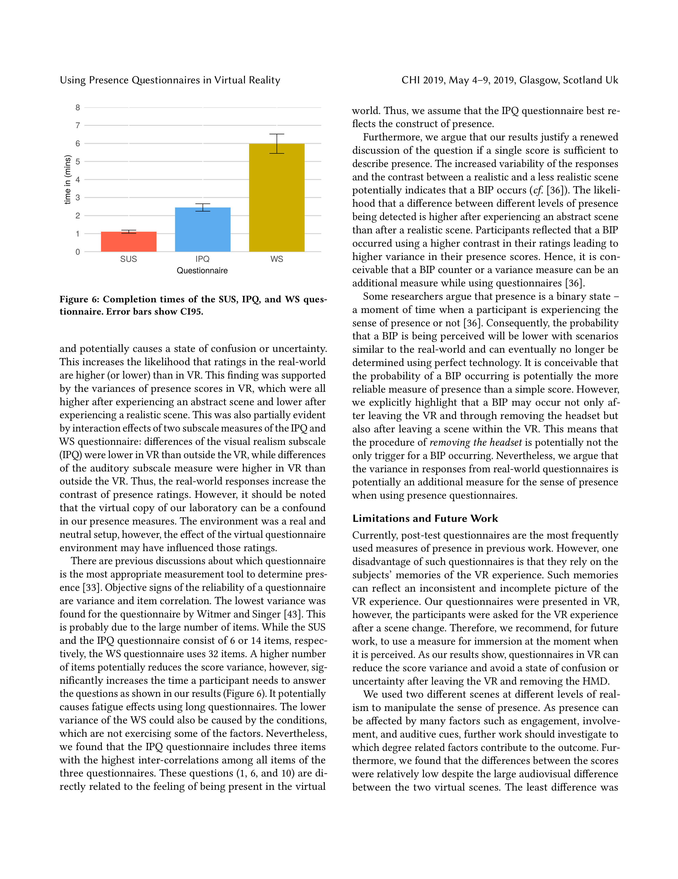
The Results
Always present your results using figures!
No pie charts
Never!
Make consistent charts, proper font sizes, colors, axis labels
Bar charts with error bars are okay
Violin and box plots can be better
Writing a Scientific Report

Slide 39
How to Report Statistics
Use Tables
Use Figures
Report what had an effect on what
“We found a main effect of Virtual Realism, F(1,34) = 11 . 518 , p = . 002; however, not of Environment, F(1,34) = . 002 ,p = . 958, and no interaction effect of Virtual Realism × Environment, F( 1 , 34 ) = . 007 ,p = . 933 on the scores of the SUS.”
What else did you analyze? And why? Make it short
“To determine potential effects of gender and previous VR experience, all analyses were repeated considering both factors as between-subject variables. None of the tests revealed statistically significant effects.”
Writing a Scientific Report

Slide 40
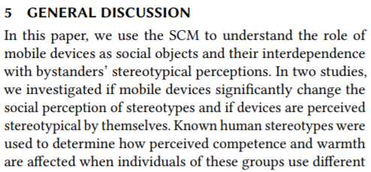
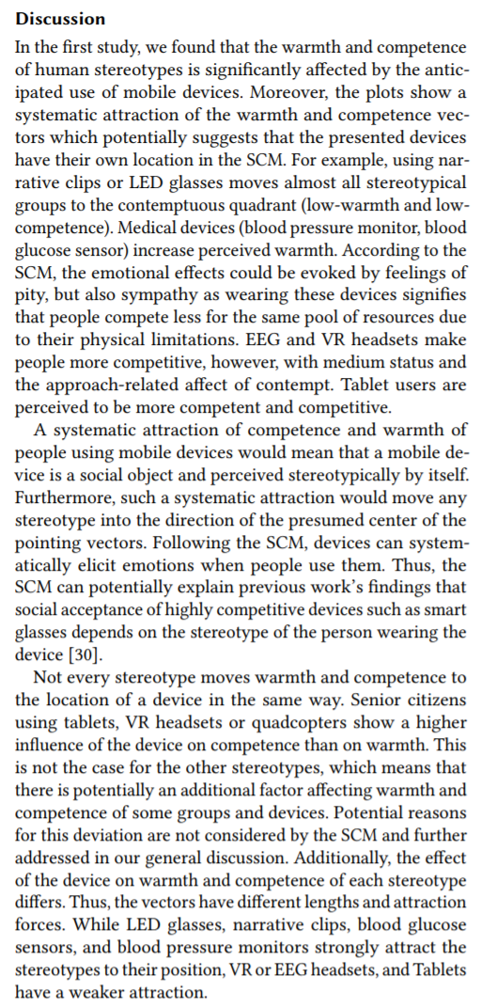
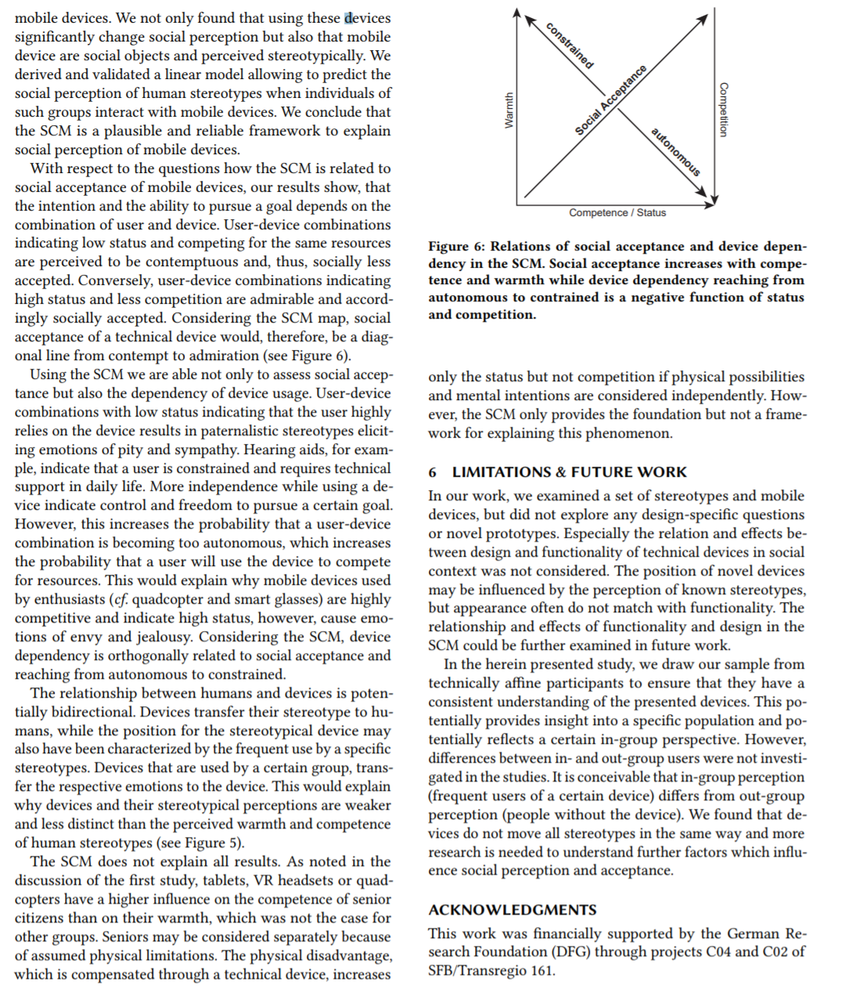
The Discussion
Typically, paper end here, if your paper has a 2nd study: proceed…
Summary of findings
Implications
Limitation & Future Work
If you have more than one study provide a General Discussion summarizing the findings from all studies
Critical Reflection/ Limitations
Critical Reflection
Writing a Scientific Report

Slide 41
The Discussion / Conclusion
A presentation of background information as well as recapitulation of the research aims of the study.
A brief summary of the results, whereas the focus lies on discussing and not recapitulating the results.
A comparison of results with previously published studies.
Conclusions or hypotheses drawn from the results, with summary of evidence for each conclusion.
Proposed follow-up research questions and outlook on further work.
Writing a Scientific Report

Slide 42
The Discussion / Conclusion
Your interpretation of the findings and your understanding what the data suggests
Highlight unexpected that came up
Sum up all findings and the significance of the outcomes
Mostly includes a limitation and future work section
Writing a Scientific Report

Slide 43
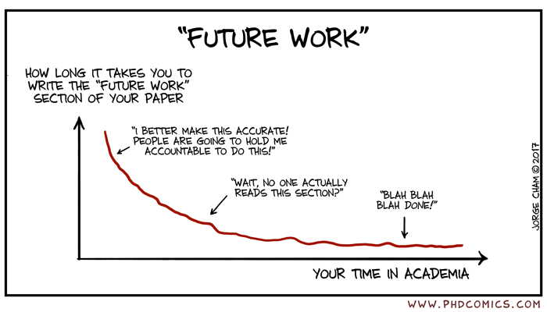
Future Work
Writing a Scientific Report

Slide 44
Images
Photos are extremely expressive
Take good photos
Photos can show things that are hard to describe
Think about the message you want to convey
Take reasonably nice photos
Remove clutter
Use a sufficiently good camera
Enough light
…
Don’t take photos of your participants, take photos of a model (which isn’t part of the group)
Can be hard if you take them too late
Writing a Scientific Report

Slide 45
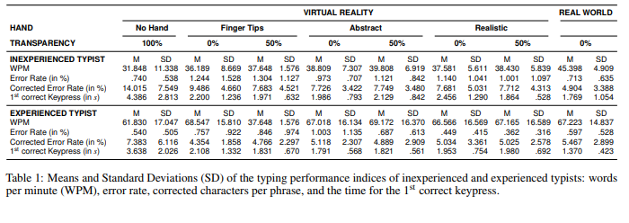
Tables
Be consistent (also with other charts and figures)
Don’t be ugly
Writing a Scientific Report

Slide 46
Structuring Results
Results describe the objective findings of your research (not the interpretation!)
Patterns from your Method (e.g. measures) must be found
Structured by
Quantitative and Qualitative Findings
Objective and Subjective Measures
Concepts
Research Questions, Hypotheses
Use sections according to your objectives
Try several ways to find the best way to present your data
Writing a Scientific Report

Slide 47
Reporting Results
Results are the core of your paper! Report them properly
Order of results according to hypotheses or metrics
Report all measures you mentioned in your method
Rule: First descriptive statistics (means, standard deviations,..), then inferential statistics (ANOVA, t-test,…)
Typical Structure:
Statement or sentence + technical details (numbers for the test in brackets)
Use past tense
Writing a Scientific Report

Slide 48
Reporting Results
Round values to three digits (no one wants to read millions of numbers):
p = 0.345678 → p = 0.346
p = 0.123456 → p = 0.123
p = 0.000001 → p < 0.001
You can aggregate multiple measures/posthoc tests if they don‘t reach significance level α < 0.05
Always report means and standard deviation in text, you can use means and CI95/SE/SD as error bars in figures
Remember CI95 can indicate if the null-hypothesis can be rejected
Writing a Scientific Report

Slide 49
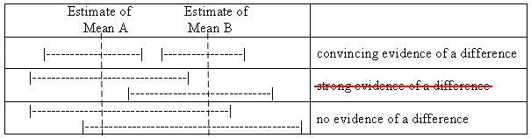
Confidence Intervals
http://mikemeredith.net/blog/1303_Comparison_of_confidence_intervals.htm
Writing a Scientific Report

Slide 50
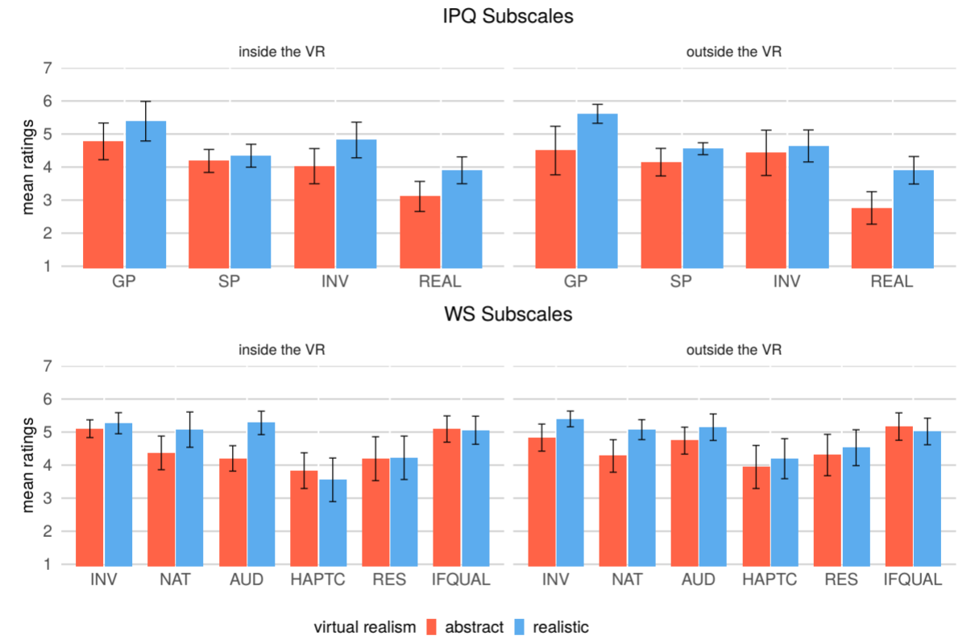
Multiple Descriptive Values
If you have many means (and many SDs) do not report them all and put them into figures and refer to that figure.
Writing a Scientific Report

Slide 51
Descriptive and Inferential Statistics
Use descriptive statistics (means, standard deviations,..)
…and inferential statistics (ANOVA, t-test,…)
Name the exact evaluation method (e.g. a one-way ANOVA)
Unusual methods need a source
Its common to add a textual summary of these findings
To investigate if virtual questionnaires cause higher workloads than questionnaires in the real-world, we performed a one-way ANOVA on the NASA-Task Load Index (TLX) scores, which were 33.16 (SD = 20.96) in VR and 37.77 (SD = 19.26) outside the VR. There were no significant effects, neither on the overall workload, F (1, 34) = .472, p = .497, nor on its sub-scales (mental, physical, temporal, performance, effort, and frustration, all with p > .111). The results indicate that perceived workload while completing the virtual questionnaires in VR had a negligible effect on the participants’ perceived workload. […] However, the workload between the questionnaires itself was not determined and could be subject of future work.
Writing a Scientific Report

Slide 52
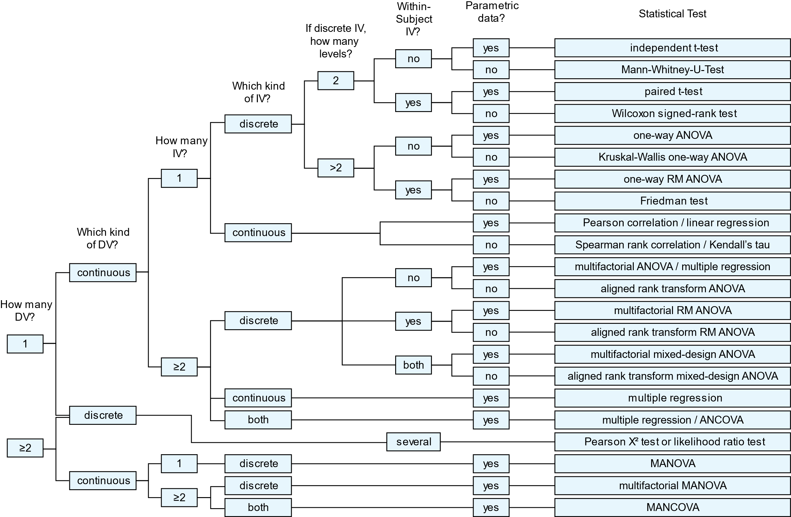
Choose wisely!
Writing a Scientific Report

Slide 53
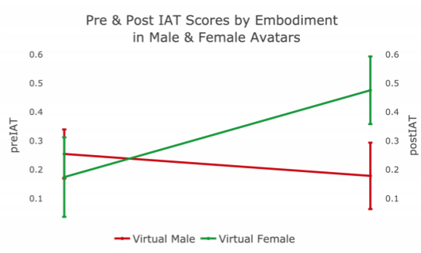
Consider the Direction!
Directed hypothesis: Avatars of the gender [….] decrease implicit biases…
Results showed that there was a significant difference in the mean ∆IAT…. Awesome….
…but wrong direction of the hypothesis for female avatars!
Writing a Scientific Report

Slide 54
Post-hoc Tests
Post-hoc tests are pairwise comparisons (t-tests, Wicoxon-signed rank tests) between all conditions
→ problem with more than two factors
If you have more than two IVs and your hypothesis includes interaction effects, report cross-factor comparisons
use phia-package in R
Provide post-hoc tests if one IV has more than two levels
Only provide post-hoc tests if your ANOVA was significant!
Writing a Scientific Report

Slide 55
How to Report Statistics
Use Tables
Use Figures
Report what had an effect on what
“We found a main effect of Virtual Realism, F(1,34) = 11 . 518 , p = . 002; however, not of Environment, F(1,34) = . 002 ,p = . 958, and no interaction effect of Virtual Realism × Environment, F( 1 , 34 ) = . 007 ,p = . 933 on the scores of the SUS.”
What else did you analyze? And why? Make it short
“To determine potential effects of gender and previous VR experience, all analyses were repeated considering both factors as between-subject variables. None of the tests revealed statistically significant effects.”
Writing a Scientific Report

Slide 56
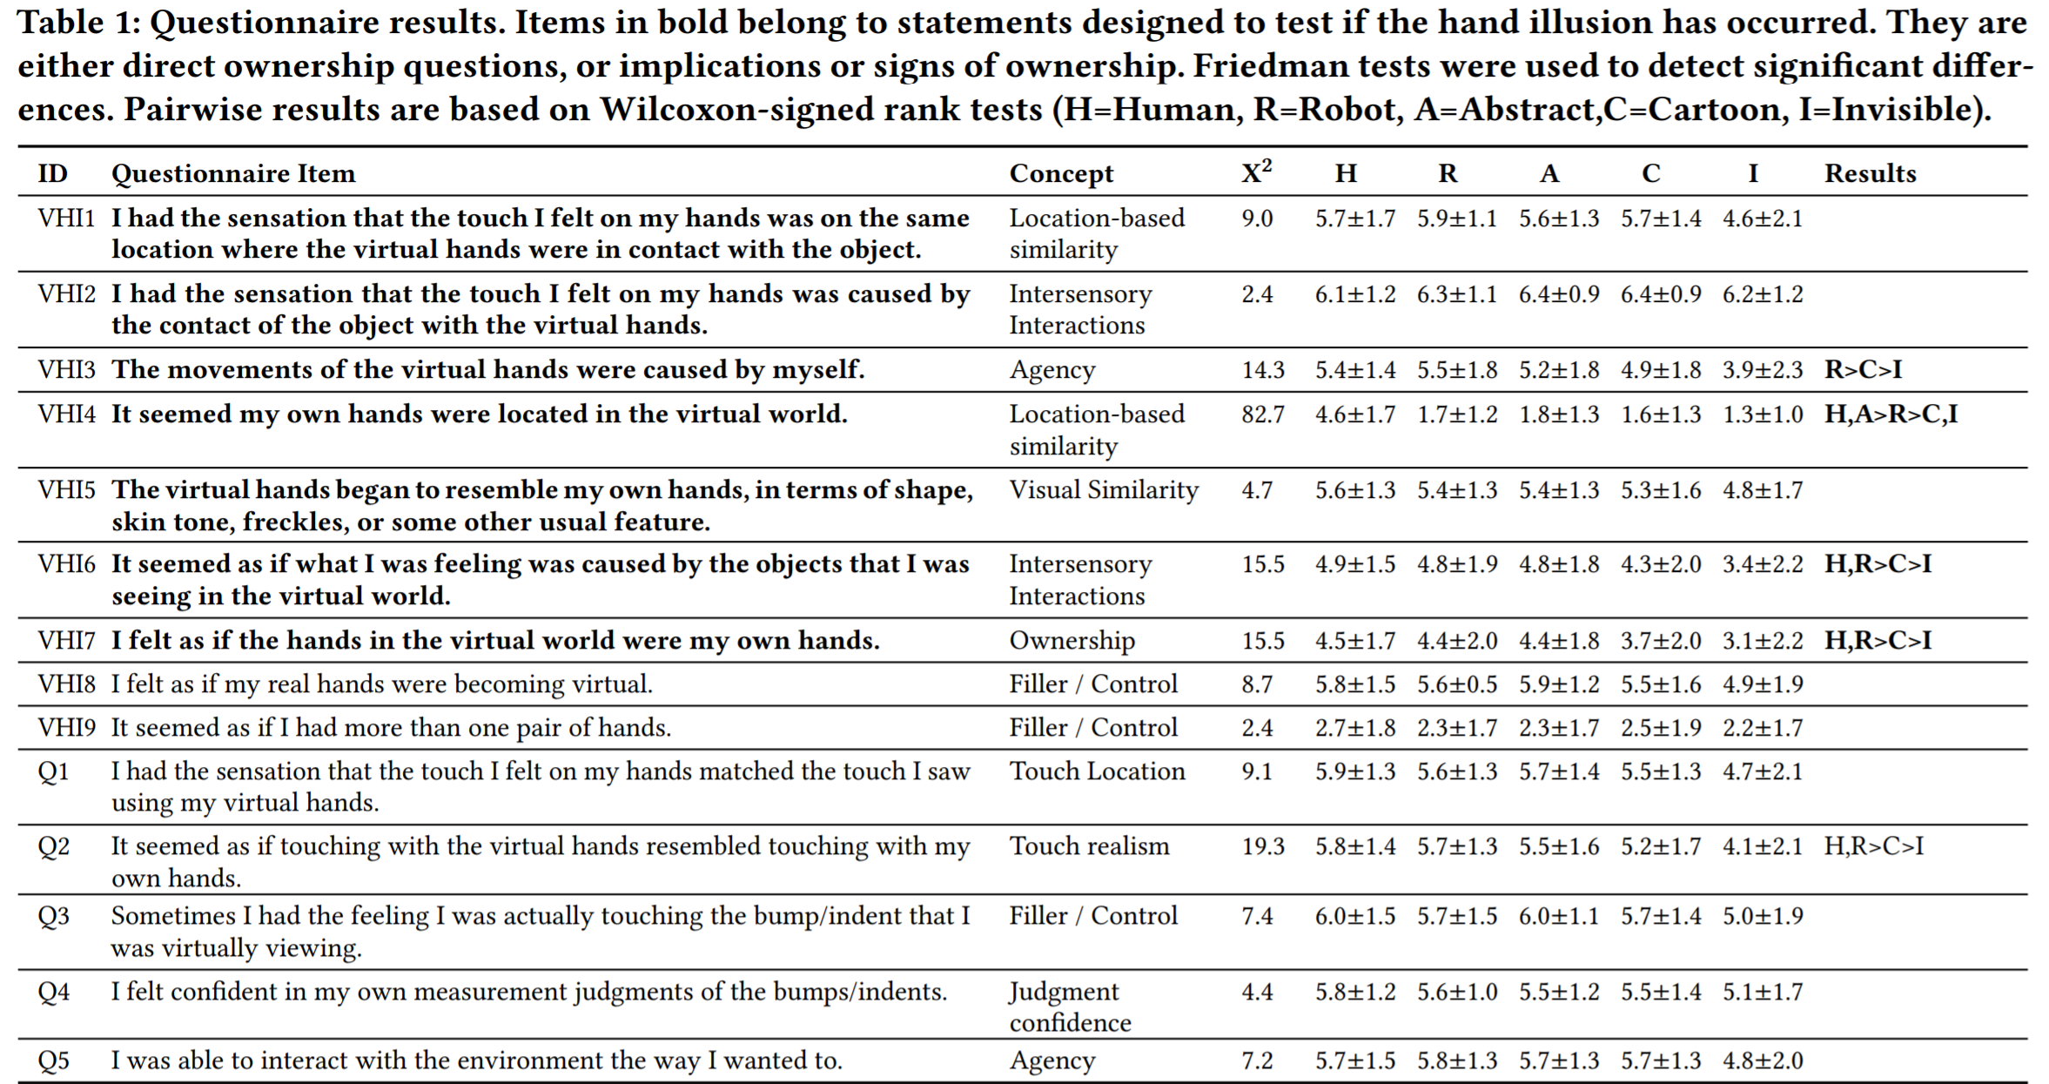
Report Statistics of Individual Items
Order individual items based on significant differences
Writing a Scientific Report

Slide 57
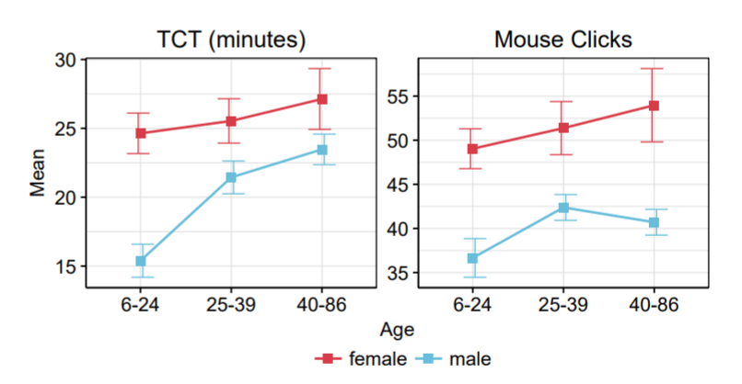
Bar Chart vs. Line Chart
Bar charts show categories
Lines show continua
You can use line charts even when you have groups as long as they depict a continuum. Example age groups:
Writing a Scientific Report

Slide 58
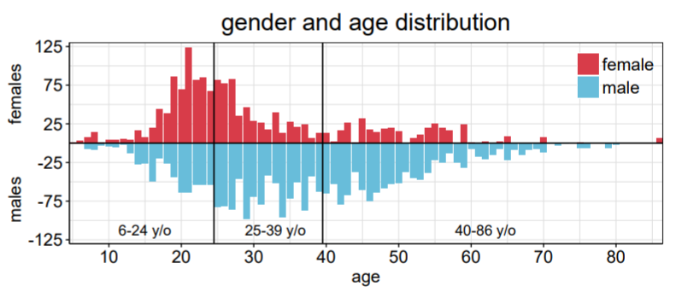
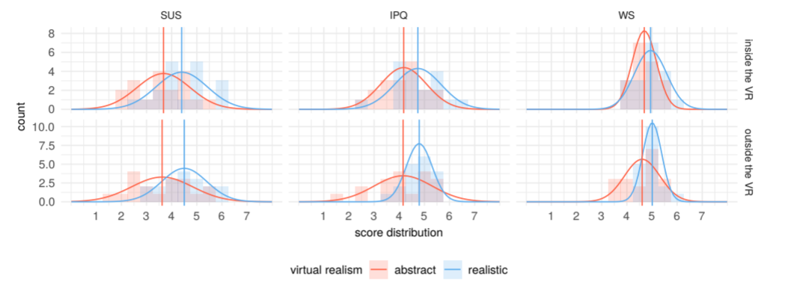
Distributions
When do I need histogram/distribution plots?
Only when occurences of values are relevant and tested to confirm or reject the (null) hypothesis
Writing a Scientific Report

Slide 59
Presentation of Data
The narrative section of the results are used to present the general findings via descriptive and inferential statistics
When tables?
Present details
Multiple data at once
Numeric, textual, avoid images in tables (!)
When figures?
When the narrative section of the results
Use subfigures, when necessary
Do not present tables and figures in text form
Tables and figures must be referenced in the text, otherwise remove them
Writing a Scientific Report

Slide 60
What should I do with all the stats now?
Repeat the whole evaluation process to check for failures
Prepare the results to answer your research questions
Derive implications from your results
Record your the whole processing and analysis of the data
Editing, Coding, Classification, Tabulation
Focus on your statistical measures
Central Tendency: Means, Median, Mode
Error/Variance: Standard Deviation
Relationsships: Correlation, Regression, t-text, ANOVA, …
Writing a Scientific Report

Slide 61
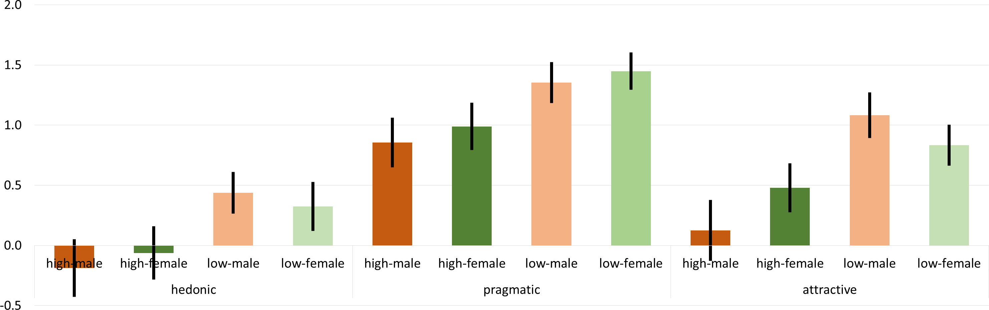
Don‘ts: Overlaps
Writing a Scientific Report

Slide 62
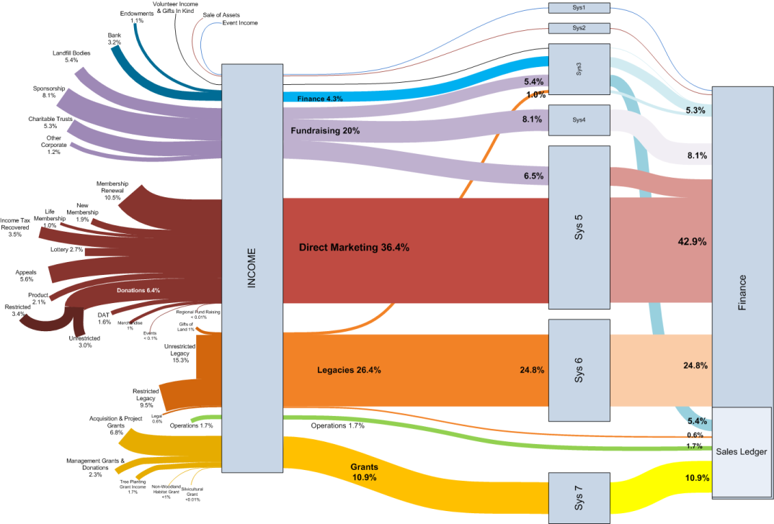
Don‘ts: Sankey Diagrams
Writing a Scientific Report

Slide 63
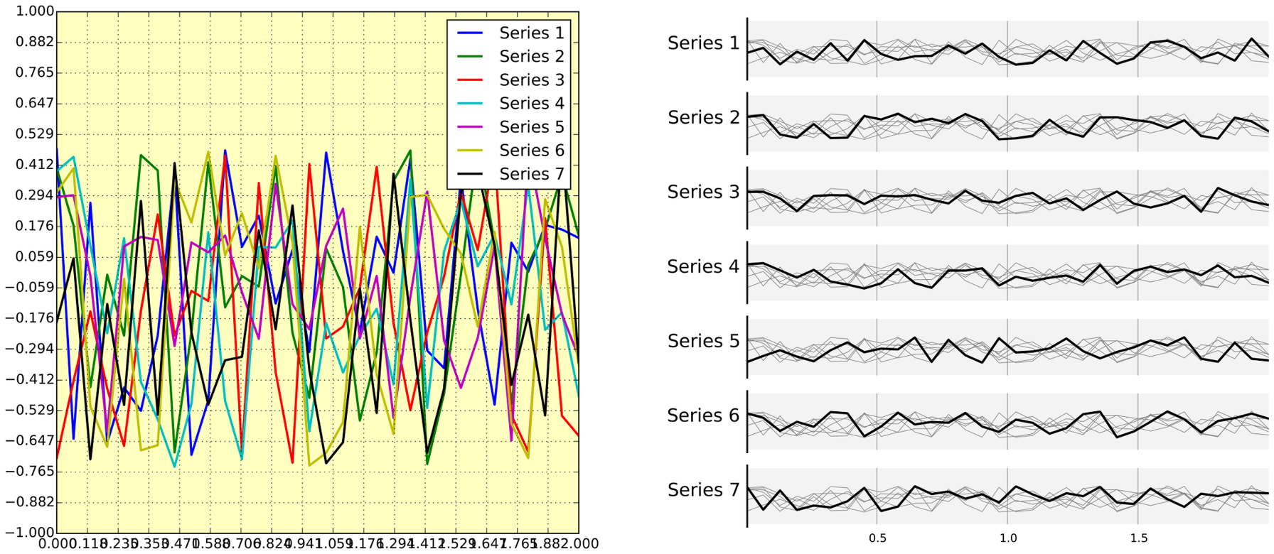
Don‘ts: Junks
Separate them!
Writing a Scientific Report

Slide 64
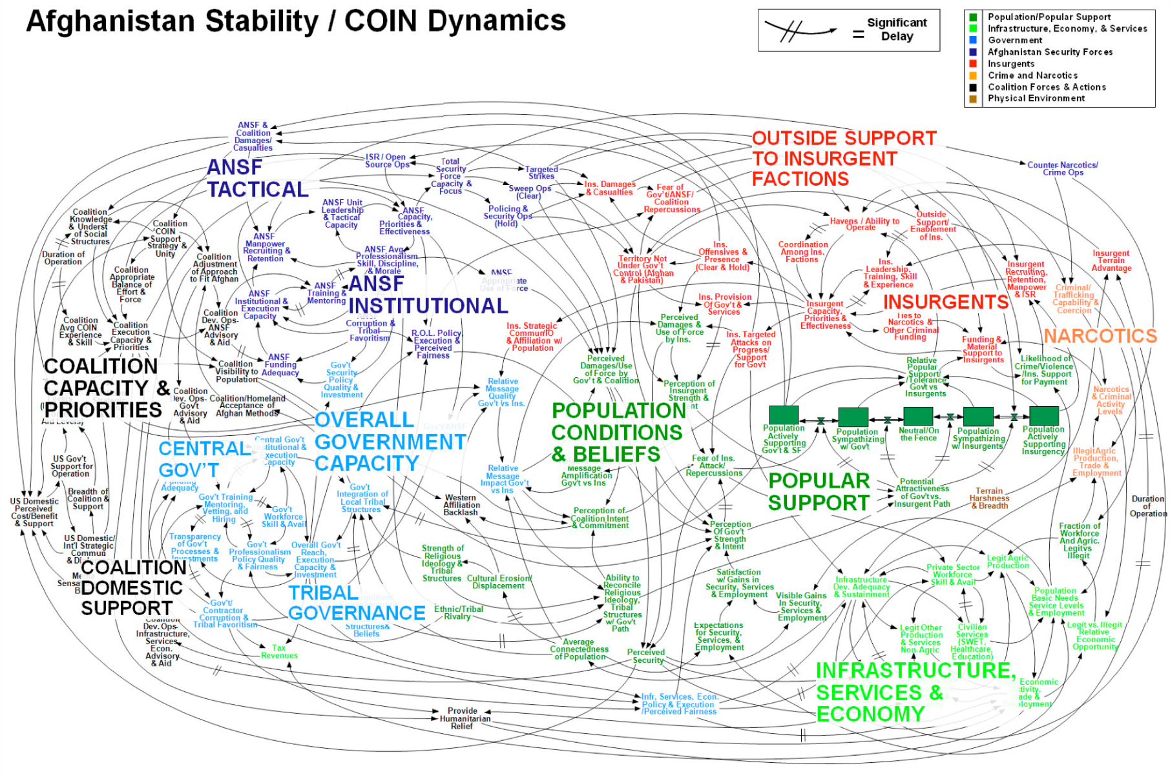
Don‘ts: Flow Charts
Writing a Scientific Report

Slide 65
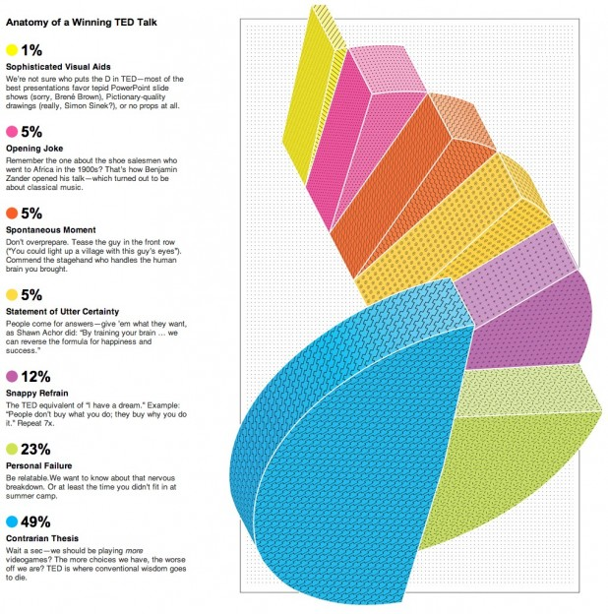
Don‘ts: JUST NO!!!!!!!
Writing a Scientific Report

Slide 66
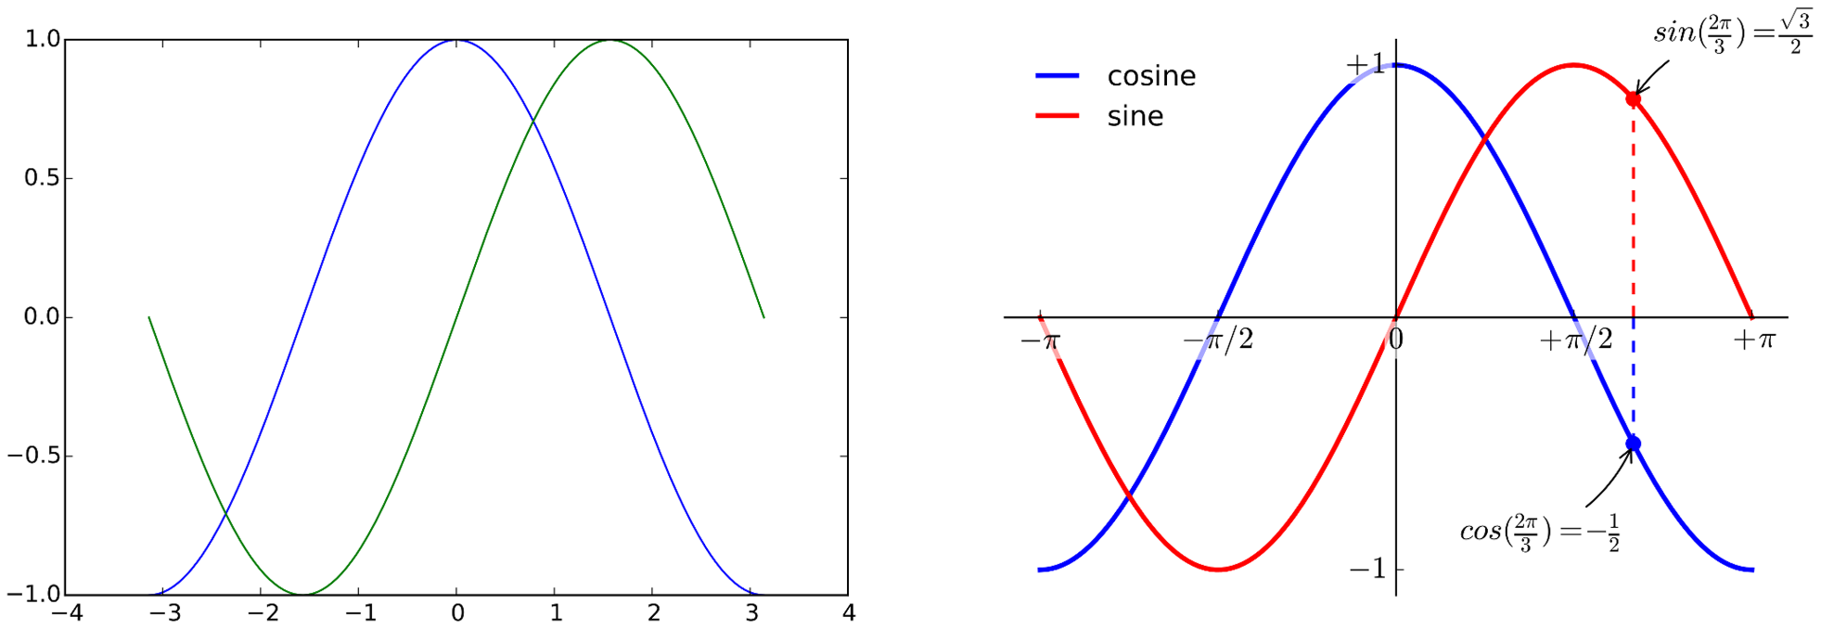
Don‘ts: Trusting Default Values
https://journals.plos.org/ploscompbiol/article?id=10.1371/journal.pcbi.1003833
Writing a Scientific Report

Slide 67
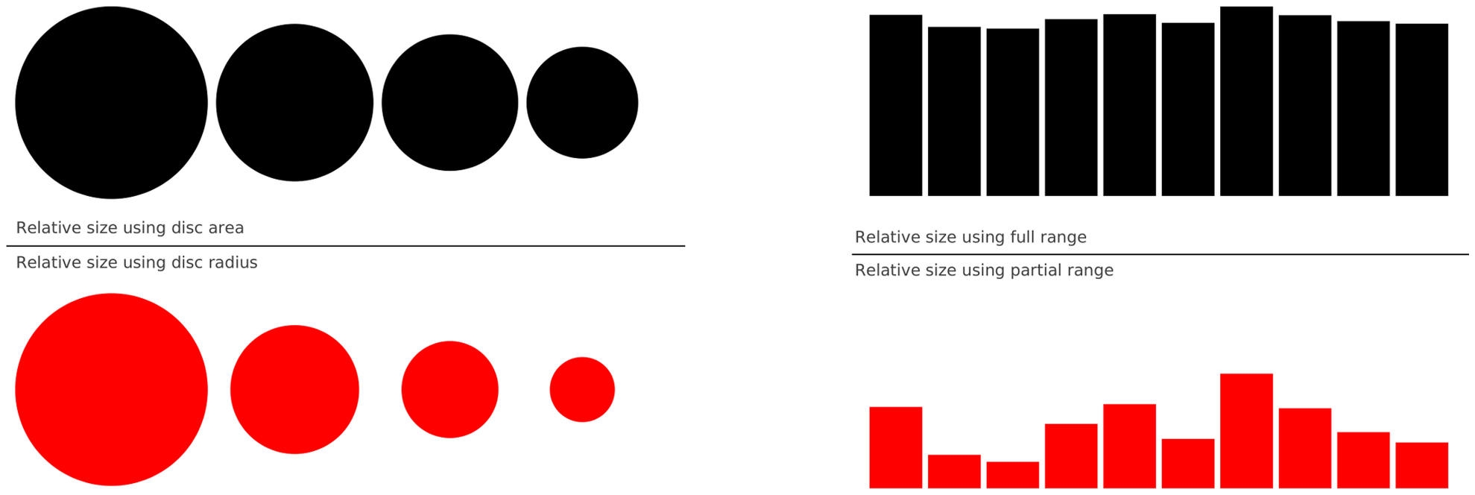
Don‘ts: Misleading
Writing a Scientific Report

Slide 68
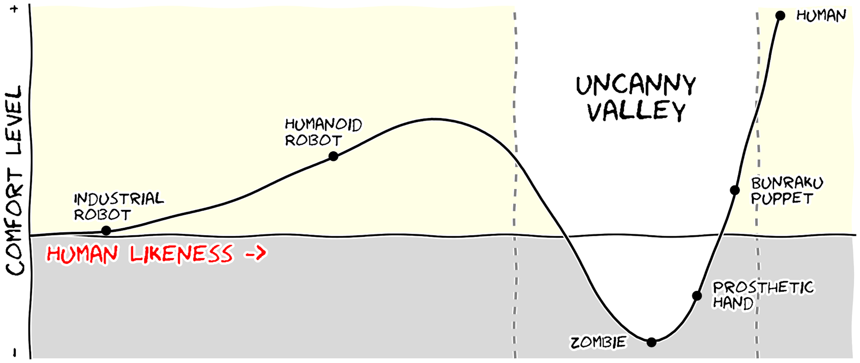
Do‘s: Message Trumps Beauty
https://journals.plos.org/ploscompbiol/article?id=10.1371/journal.pcbi.1003833
Writing a Scientific Report

Slide 69
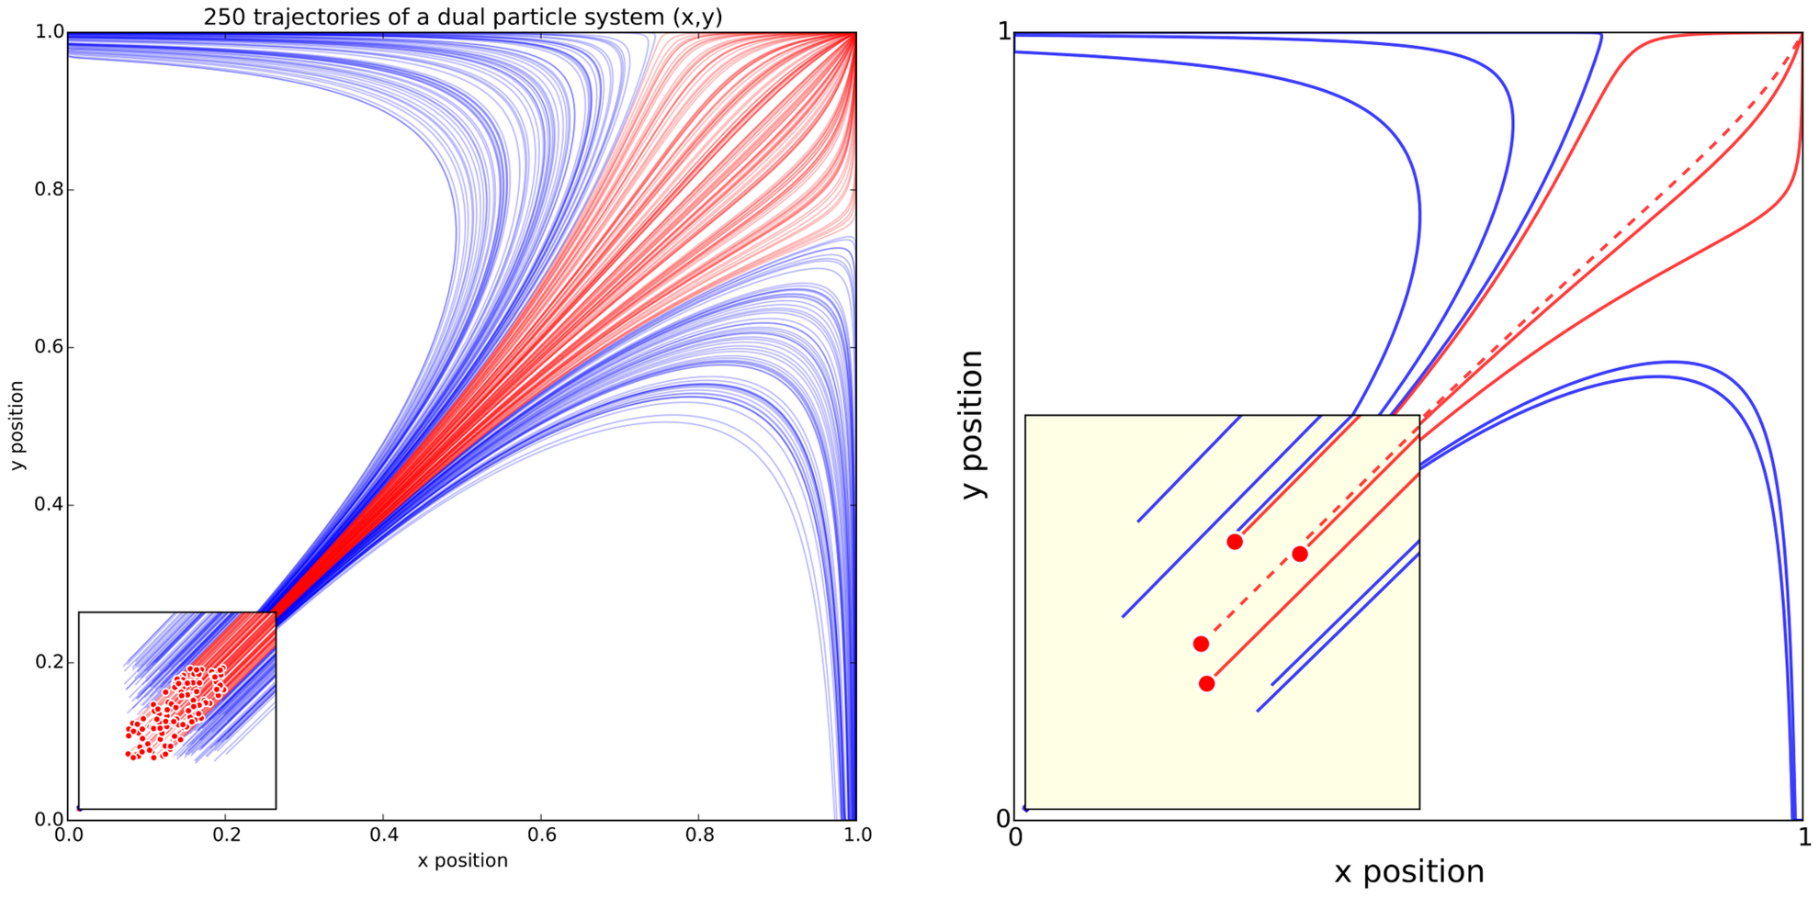
Do‘s: Adapt Where Necessary!
Writing a Scientific Report

Slide 70
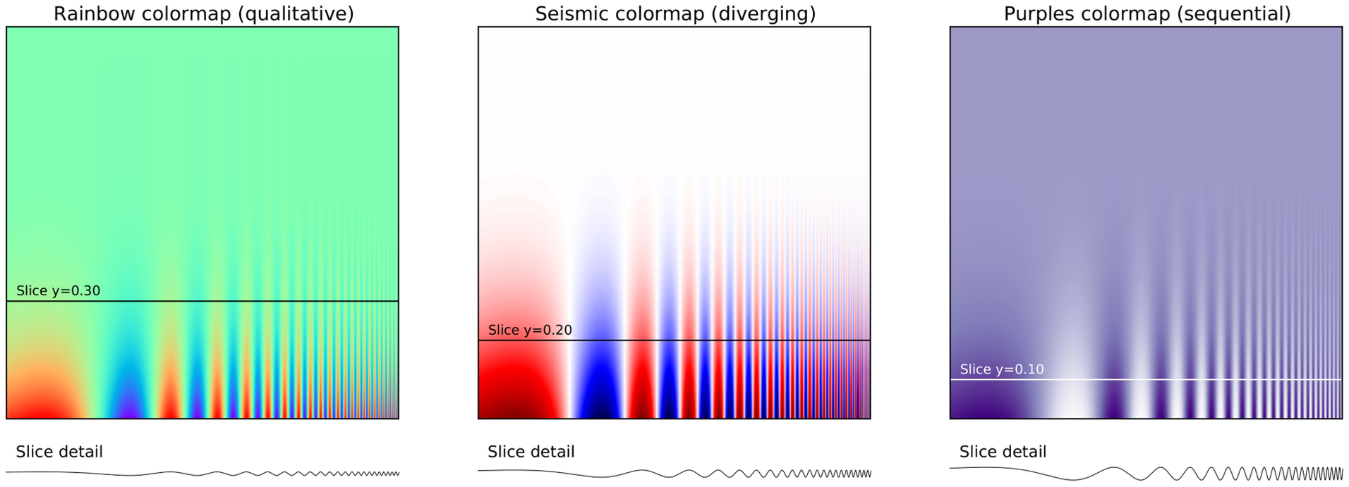
Do‘s: Use colors effectively
https://journals.plos.org/ploscompbiol/article?id=10.1371/journal.pcbi.1003833
Writing a Scientific Report

Slide 71
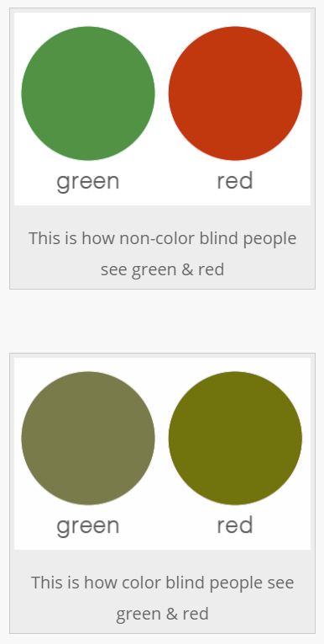
Do‘s: Make Figures Accessible
https://www.somersault1824.com/tips-for-designing-scientific-figures-for-color-blind-readers/
Writing a Scientific Report

Slide 72
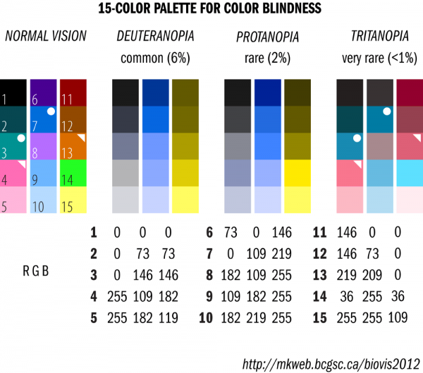
Do‘s: Make Figures Accessible
https://www.somersault1824.com/tips-for-designing-scientific-figures-for-color-blind-readers/
Writing a Scientific Report

Slide 73
Results Interpretation
Interpretation is the process of analyzing measures and scores
Interpretation is the application of scientific knowledge and professional judgement to make inferences about individual groups or characteristics
Be careful with absolute scores (e.g. SUS, NASA TLX). Scientific research only compares between conditions in one study.
Consider the criterions of your tests (e.g. alpha level, effect sizes, correlations strength, etc.)
Writing a Scientific Report

Slide 74
Discussion
Explaing your results for normal humans
Explain the meaning of the information in easily understood terms
How were reliability and validity were maintained
Stating cause for your results
Discuss the meaning of the results
State clearly what their significance is
Compare the results with
Theoretical expectations (e.g. based on models)
Findings in previous work
Use present tense to make generalizations
Writing a Scientific Report

Slide 75
Discussion
Discuss weaknesses
Explain non-significant
Explain if significant but opposite to those predicted
Explain why
Explain inconsistent or mixed results
Identify unexpected data
Compare results with previous work
Writing a Scientific Report

Slide 76
Conclusion
The researcher attempts to show what knowledge has been gained through the study and tries to generalize that knowledge by considering the population and characteristics of the sample
Was the problem answered?
Was the research purpose met?
Was the research hypothesis supported?
Was the theoretical model/framework/predictions supported?
Provide implications. Give others the opportunity to be creative. Implications give meaning for theory and pratice
Provide suggestions for making changes, further studies, etc.
Writing a Scientific Report

Slide 77
Conclusion
Provide recommendations
Logical extension of your study: What comes next?
Replication of the study: Different setting?
Correction of limitations: Sample, apparatus, variable control, method
Utilize your findings
What can we do with that?
Must a mode
Writing a Scientific Report

Slide 78
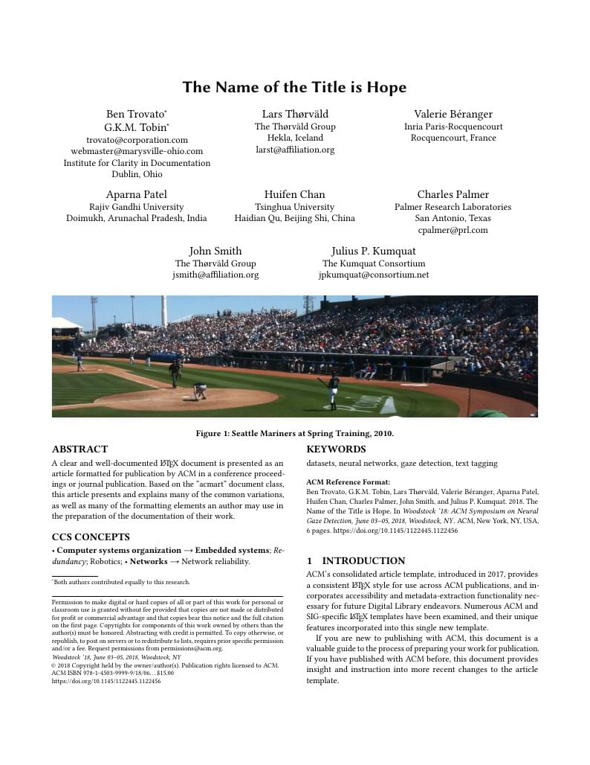
Your Template
Take the ACM SIGCHI master template (2019)
Find a Latex-Editor
Learn to collaborate
https://www.overleaf.com/latex/templates/acm-conference-proceedings-new-master-template/
Writing a Scientific Report

Slide 79
Task Next Time
Setup your document
Write a drafted abstract (abstracts include results but you don’t have them → not bad, just write what you except)
Look into: “How to write a scientific abstract” https://www.easterbrook.ca/steve/2010/01/how-to-write-a-scientific-abstract-in-six-easy-steps/
Write an introduction
Add the other (but still empty) sections you are planning to do → structure them
You can add: placeholder
Upload your submission
Writing a Scientific Report

